Slide 1
Azure Community Conference

Slide 2



Title Sponsor
Gold Sponsor
Community Partner

Slide 3

Ravikanth Chaganti
Distinguished Member Technical Staff, Dell EMC
@ravikanth

Slide 4
Azure Policy Guest Configuration
Deep dive

Slide 5
Agenda
Azure Policy primer
Introduction to Guest Configuration
Guest Configuration internals
Demo

Slide 6
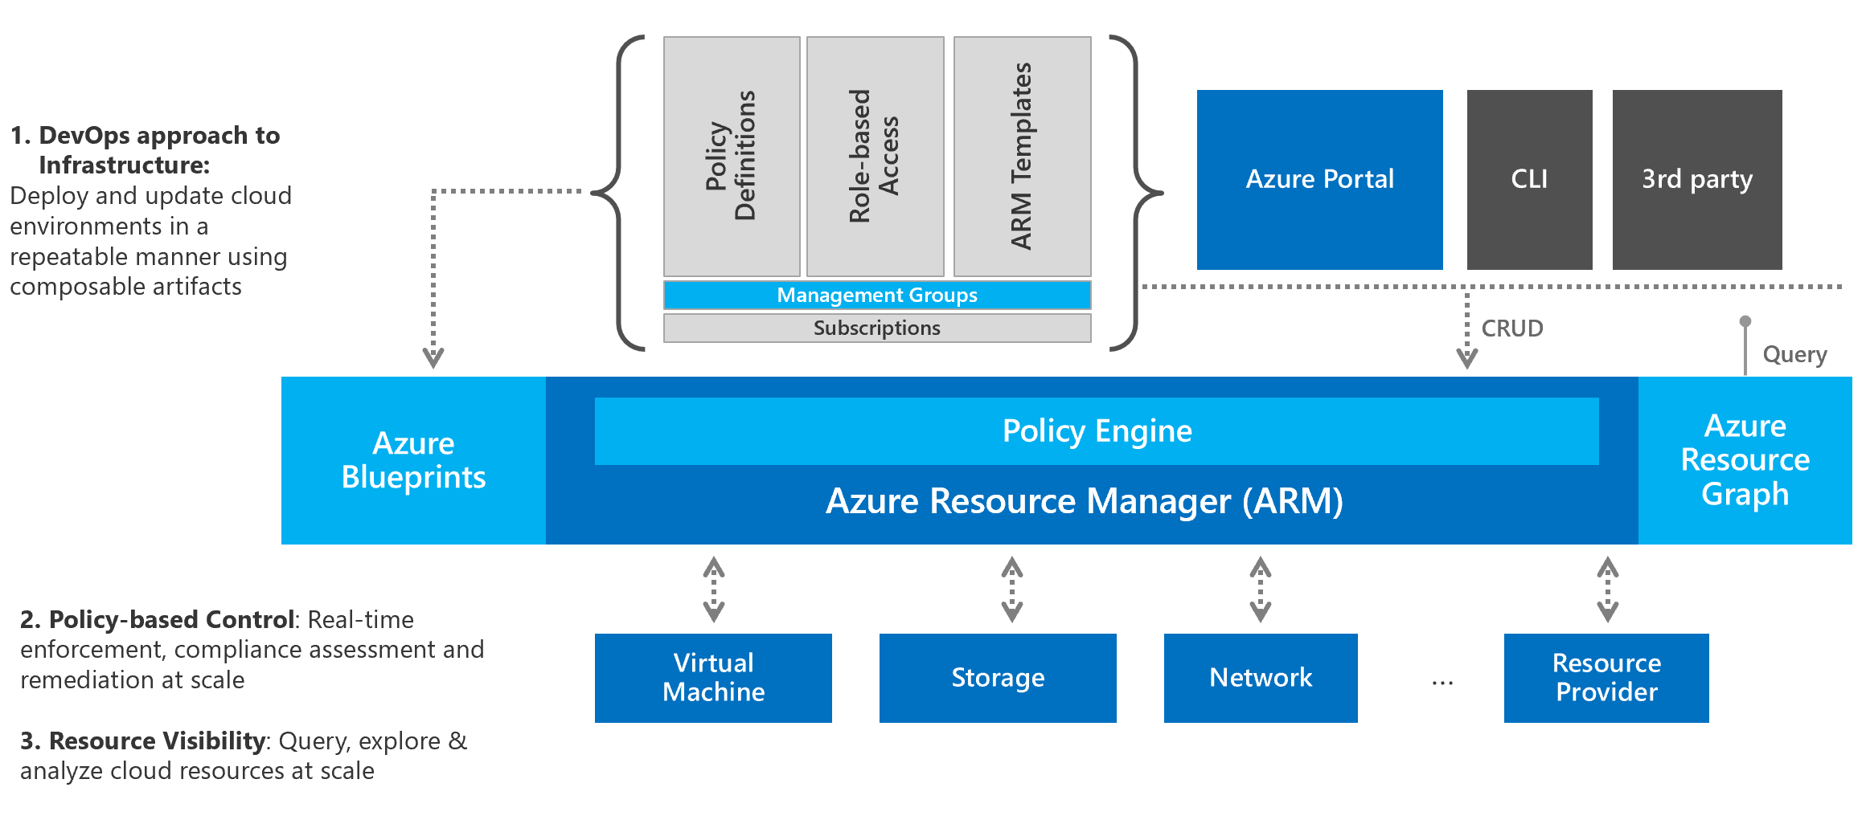
Azure Policy Primer
Within Azure, Governance refers to the ongoing process of managing, monitoring, and auditing the use of Azure resources.

Slide 7
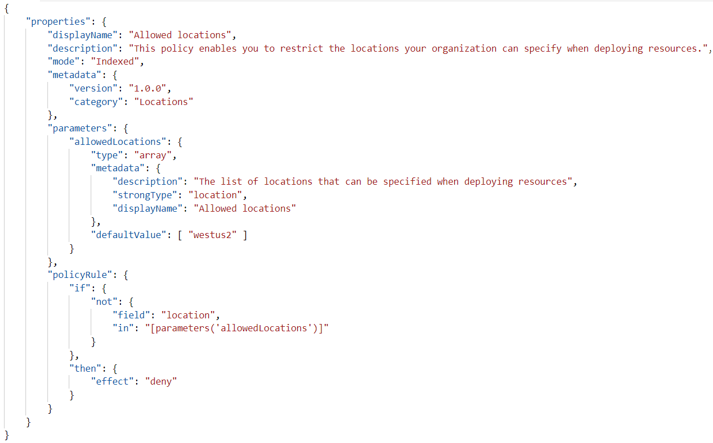
Evaluation Mode: all or indexed
Policy Condition
Policy Effect

Slide 8
Effect Order

Slide 9


Policies
Initiatives
Assignment Scope
Management Groups
Subscriptions
Resource Groups
Resources

Slide 10


Azure CLI
Azure PowerShell
Azure Resource Manager
Resource Providers
ARM Templates
Azure SDK

Slide 11
Demo Title

Slide 12





Our Partners

Slide 13

Communities

Slide 14
Q & A

Slide 15
Feedback

Slide 16
THANK YOU!
Ravikanth Chaganti
@ravichaganti

